Slide 1

Prisemi技术交流_手表
PRISEMI芯导授权代理KOYUELEC光与电子
电话0755-82542001，82574660谢谢惠顾~
科技创芯·导引未来
Innovation for Future

Slide 2
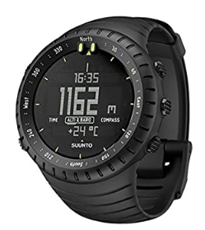



智能手表---市场品牌

Slide 3
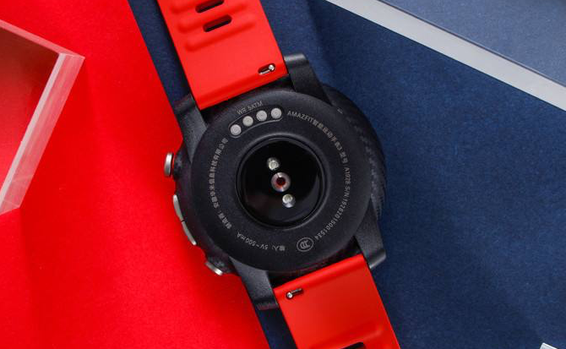
智能手表---充电接口
Vbus
USB Type-C
ID
USB
USB Pin
Micro USB
GND
Vbus | GND
触点磁吸
Vbus | ID | GND
Vbus | D+ | D- | GND

Slide 4
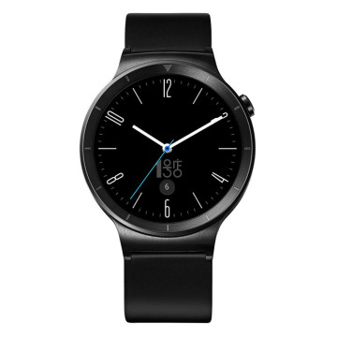
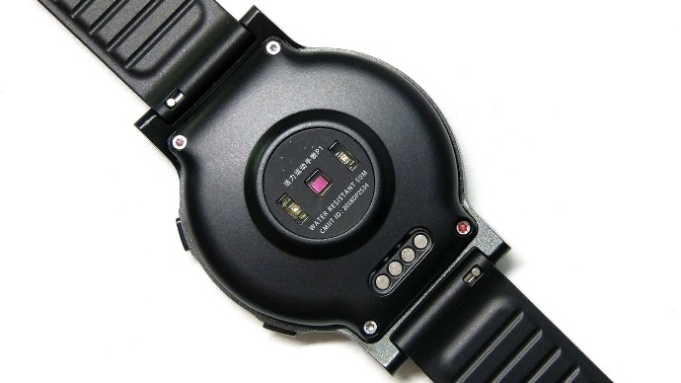
按键、SIM卡接口静电保护
喇叭、MIC、触摸、传感器、LED灯等常规接口静电保护
电池端浪涌
静电保护
4G天线、NFC天线静电保护
I2C，复位等接口静电保护（看具体电路）
GPS天线静电保护
手表/手环静电保护
充电口浪涌
静电保护
D+D-浪涌
静电保护
产品型号 | 极性 | Vrwm | Ipp | Vc | Cj | Package | 静电能力 | 应用
PESDNC2XD3V3B PESDNC2XD3V3BF | Bi | 3.3V | 6A 9A | 8V 8.5V | 12PF 19PF | DFN0603-2L | Air：30KV Contact：30KV | 喇叭、MIC、触摸、传感器、LED灯等常规接口静电保护
PESDNC2XD5VB PESDNC2XD3V3B | Bi | 5V 3.3V | 5A 6A | 9.5V 8V | 15PF 12PF | DFN0603-2L | Air：30KV Contact：30KV | I2C、复位等接口静电保护
PESDNC2XD5VB | Bi | 5V | 5A | 9.5V | 15PF | DFN0603-2L | Air：30KV Contact：30KV | 按键、SIM卡接口静电保护
PESDMC2XD18VB | Bi | 18V | 4A | 8V | 0.4pF | DFN0603-2L | Air：15KV Contact：15KV | 4G天线、NFC天线静电保护
PESDUC2XD5VB | Bi | 5V | 4A | 21V | 0.4pF | DFN0603-2L | Air：15KV Contact：15KV | GPS天线静电保护
手表/手环浪涌静电保护
产品型号 | 极性 | Vrwm | Ipp | Vc | Cj | Package | 静电能力 | 应用
PTVSHC2EN4V8UF | Uni | 4.8V | 180A | 9.0 | 530PF | DFN1610-2L | Air：30KV Contact：30KV | 电池端浪涌静电保护
PESDHC2EN12VU | Uni | 12V | 65A | 9.5V | 150PF | DFN1610-2L | Air：30KV Contact：30KV | 充电口浪涌静电保护
PESDLC2FD5VUH | Uni | 5V | 8A | 15V | 1.1pF | DFN1006-2L | Air：30KV Contact：30KV | D+D-浪涌静电保护

Slide 5
智能手表---浪涌防护方案
300V浪涌防护 :
DFN1610 ---- PTVSHC2EN6V3UA
DFN1610 ---- PTVSHC2EN7VB
DFN1610 ---- PTVSHC2EN12VBF
200V浪涌防护 :
DFN1610 ---- PTVSHC2EN6V3UA
DNF1006 ---- PESDHC2FD6V3UF *2
100V浪涌防护 :
DFN1610 ---- PTVSHC2EN7VU
DNF1006 ---- PESDHC2FD6V3UF
Vbus
300V浪涌防护 :
DFN1610 ---- PTVSHC2EN4V8UF
Vbat

Slide 6

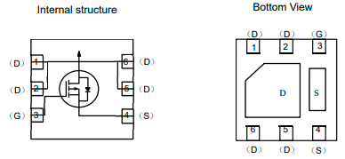

Prisemi
TVS +MOS+OVP + Charger IC
Solution
应用特点：
30V输入耐压
Typical 21m欧姆导通阻抗
低漏电流设计方案
OVP响应时间50ns
用于手机，平板, 可穿戴设备，TWS,洗护用品
磁吸式触点
VBUS
Charger
System
PMOS
OVP
MCU
锂电池
Part Number | R_{DS(ON)_Typ.} | Operating V_{IN_Min.} | Operating V_{IN_Max.} | Max Input DC Voltage | Default OVP Threshold | Adjustable OVP Threshold Range | OCP Setting Range | Max Continous Current | with Fault Status Ouput | with Gate Control Ouput | Package
 | (mΩ) | (V) | (V) | (V) | (V) | (V) | (A) | (A) | (Y/N) | (Y/N)
P1405A | 30 | 3 | 5.5 | 32 | 6.0 | Fixed | - | 3.0 | N | N | DFN2X2-6L
P14C1N | 220 | 3.5 | 5.5 | 32 | 6 | Fixed | 0.1-1.5 | 1.2 | Y | N | DFN2x2-8L
P14C1S | 200 | 3.5 | 5.5 | 32 | 6.0 | Fixed | 0.1-1.2 | 1.2 | N | N | SOT23-6L
P14C13 | 250 | 3.5 | 5.5 | 32 | 6 | Fixed | - | 1 | N | N | SOT23
P14C10D | 340 | 3.0 | 5.5 | 30 | 5.8 | Fixed | Fixed 1.1 | 0.8 | N | N | SOT23
P14C2N | 170 | 3.5 | 5.5 | 32 | 6 | Fixed | 0.1-1.5 | 1.2 | Y | N | DFN2x2-8L
P14C3M | 105 | 3.5 | 5.5 | 40 | 6 | Fixed | 0.2-3.0 | 2 | N | N | DFN1.2x1.6-4L
P14C3NT | 85 | 3.5 | 5.5 | 40 | 6 | 4.0-16 | 0.2-3.0 | 2.5 | N | N | SOT23-6L
P14C3NS | 85 | 3.5 | 5.5 | 40 | 6 | 4.0-16 | - | 2.5 | N | N | SOT23-6L
P14C3ND | 79 | 3.5 | 5.5 | 40 | 6 | 4.0-16 | 0.2-3.0 | 2.5 | Y | Y | DFN2x2-8L
P14C5N | 55 | 3.5 | 6.0 | 30 | 6.8 | 4.5-16 | 0.3-3.0 | 3.0 | Y | N | DFN2x2-8L

Slide 7
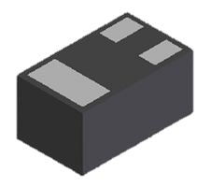
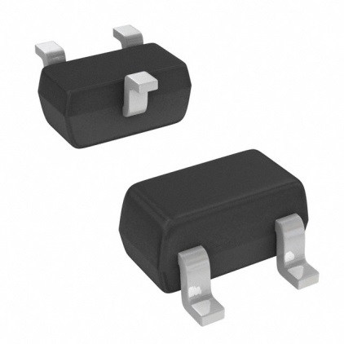
Prisemi Small Package MOS
马达驱动;GPS驱动;屏驱动(TFT);充电指示灯驱动;
PNM3FD20V1E
建议推荐方案
DFN1006-3L
PPM3FD20V2
PNM723T201E0
SOT723
PNM723T703E0-2
铼锶方案 ,单机3
PNM523T201E0
SOT523
PNM523T703E0-2
** 如有充电指示灯功能有MOS管的机会

Slide 8
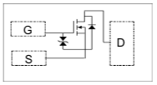
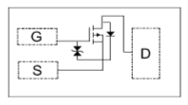
Prisemi Small Package DFN1006-3L MOS
PNM3FD20V1E
NMOS
0.6mm
1.0mm
DFN1006-3L
PPM3FD20V1E
PMOS
Prisemi | Parameter | Symbol | Value | Unit | Package
PNM3FD20V1E | Drain-Source | VDS | ﹢20 | V | DFN1006-3L
 | Gate-Source | VGS | ± 8 | V
 | Continuous Drain | ID | 1 | A
PPM3FD20V1E | Drain-Source | VDS | ﹣20 | V | DFN1006-3L
 | Gate-Source | VGS | ± 10 | V
 | Continuous Drain | ID | ﹣800 | mA

Slide 9
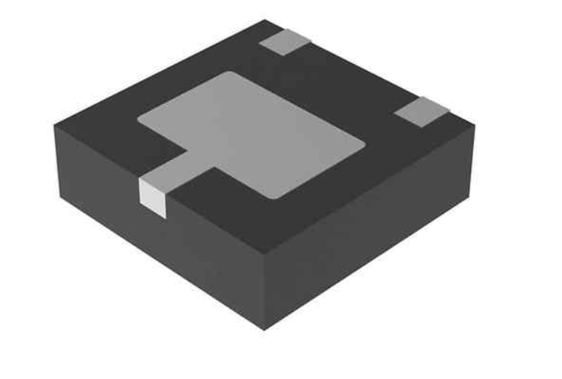
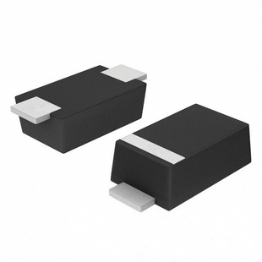

Prisemi- Solution For Vbus/Vbat
DFN2020
SOD123-FL
DFN1610
主流封装: DFN2020 & SOD123-FL(超薄) & DFN1610
可选封装: SOD323 & DFN1006 & DFN0603

Slide 10
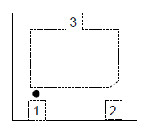


DFN2020 EOS Solution
3
Power
Line
0.65mm(MAX)
2.0mm
GND
1.2
DFN2020 Parts | Vrwm | EOS/Surge 8/20us | ESD Contact
PTVSHC2EN4V5B | 4.5V(Bi) | 130A | 30kV
PTVSHC2EN4V8UA | 4.8V | 170A | 30kV
PTVSHC2EN4V8UF | 4.8V | 180A | 30kV
PTVSHC3N12VUM | 12V | 200A | 30kV
PTVSHC3N15VUHM | 15V | 180A | 30kV
PTVSHC3N18VUM | 18V | 180A | 30kV
PTVSHC3N24VUPM | 24V | 180A | 30kV
PTVSHC3N24VUPL | 24V | 260A | 30kV
PTVSHC3N30VUPL | 30V | 240A | 30kV
VBat
VBus

Slide 11
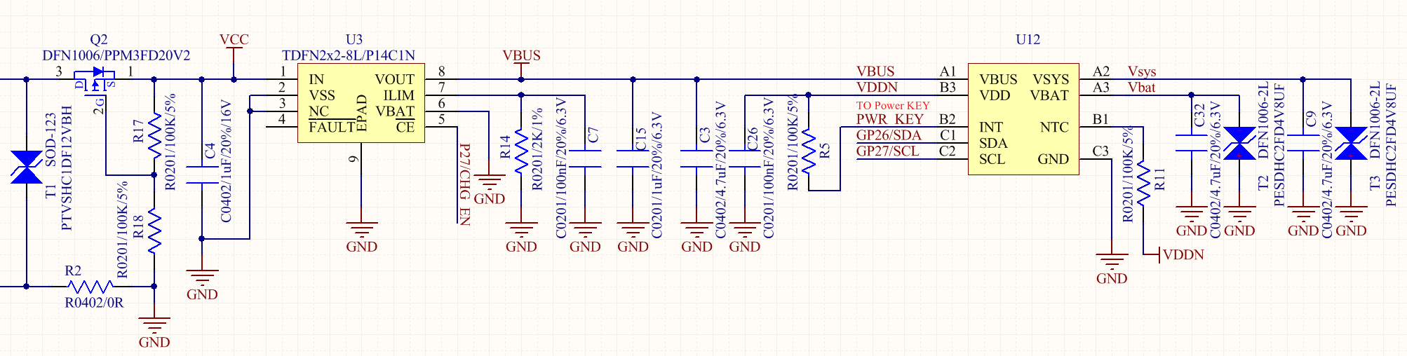
SOD123-FL EOS Solution
DFN2020 Parts | Vrwm | EOS/Surge 8/20us | ESD Contact
PTVSHC1TF12VU | 12V | 170A | 30kV
PTVSHC1DF12VBH | 12V(Bi) | 160A | 30kV
PTVSHC1TF15VU | 15V | 250A | 30kV
PTVSHC1SF18VBH | 18V(Bi) | 220A | 30kV
PTVSHC1TF24VU | 24V | 180A | 30kV
PTVSHC1SF24VBH | 24V(Bi) | 180A | 30kV
Application:

Slide 12
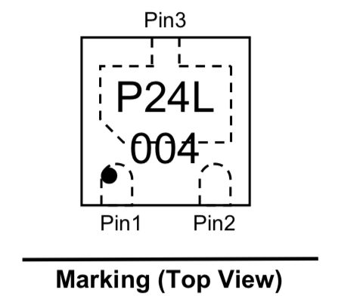
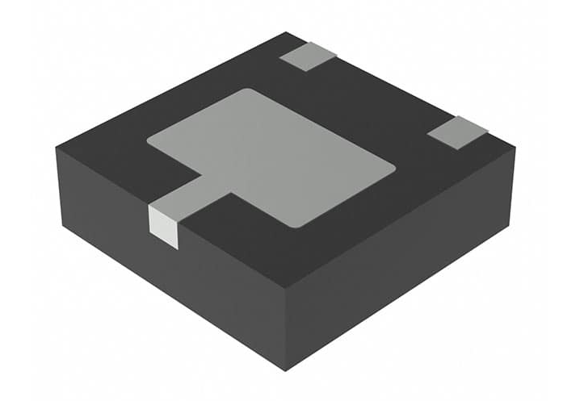
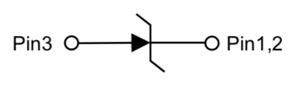
24V单向TVS负向浪涌加强版
Prisemi PTVSHC3N24VUPL
—— 24V/Ui DF2020 TVS
Feature：
9500W Ppk(tp=8/20us)
Low Clamping Voltage
  IPP=100A@VC=6.35V(8/20us负向)
DFN2020 Package (2.0mm*2.0mm*0.5mm)
IEC 61000-4-2(ESD) : ±30kV(Air & Contact)
IEC 61000-4-5(Lightning) : 260A(8/20us)
  24V TVS
  Surge Test Data 钳位电压
  PTVSHC3N24VUPLSurge Test Data
  钳位电压
负向浪涌的钳位电压越低越好,可以有效保护后端的IC器件.

Slide 13

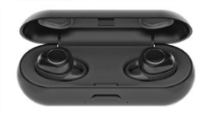
DFN1610 EOS Solution
——PTVSHC2EN4V8UA 4.8V/Ui DFN1610 TVS
Feature：
2000W Ppk(tp=8/20us)
Low Clamping Voltage
  IPP=180A@VC=10.8V
DFN1006-2L Package (1.6mm*1.0mm)
IEC 61000-4-2(ESD) : ±30kV(Air & Contact)
IEC 61000-4-5(Lightning) : 180A(8/20us)
  TLP : 16A@VC=6V
TLP Current (A)
Snap-Back
Technology
Applications：
Battery Port(V-bat) Surge & ESD protection.
≤4.8V power line Surge & ESD protection.
Protection : Phone & Smart Speakers & PAD & TWS……
TLP Voltage (V)
Low Clamping Voltage
Surge
Performance 425V@VC=15.5V
VC-Clamping Voltage (V)

Slide 14
Prisemi PESDRC2FD12VBH
—— 12V/Bi DFN1006 TVS
Feature：
135W Ppk(tp=8/20us)
Junction Capacitance : 1.3pF(Max)
Clamping Voltage
  TLP=16A@VC=7V
  IPP=18A@VC=7.5V
0402 DFN1006-2L Package (1.0mm*0.6mm)
IEC 61000-4-2(ESD) : ±30kV(Air & Contact)
IEC 61000-4-5(Lightning) : 18A(8/20us)
Surge
Performance 49V@VC=8.2V
VC-Clamping Voltage (V)
Protection – DP/DM
Surge Voltage(V)
Applications：
USB Type-C (D+/D- ) ESD protection.
USB 2.0 EOS / ESD protection.
Protection : Phone & PAD......
Surge
Performance 53V@VC=8.68V
VC-Clamping Voltage (V)
Surge Voltage(V)

Slide 15

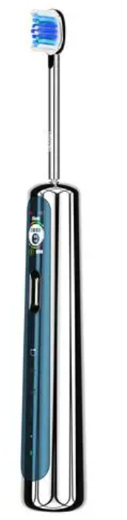
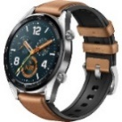

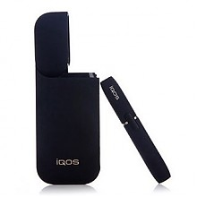
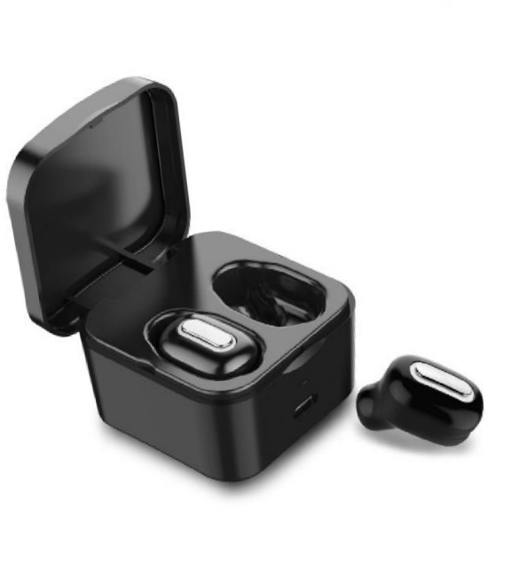
Prisemi OVP 产品介绍
OVP 全系列产品
最大支持40V直流耐压（P14C3N系列）
超小封装DFN1.2*1.6（P14C1M）
多档位Rdson可选择：30~220mohm
过流保护精度10%
过压保护响应速度50ns
支持外挂MOS方案，电流可扩展8A
搭配我司TVS，可以过±300V以上浪涌及24/28V热插拔
主要成功案例：TWS耳机，电子烟，手表，电动牙刷,小音响等
Charger
Load
Part No. | Package | Rdson | Max DC | OVP | OCP | OCP恢复 | 支持外挂MOS | 对标型号 | 主要应用
P1405A | DFN2*2-6 | 30mohm | 30V | 6V | / | / | / | / | 电子烟，音响
P14C5N | DFN2*2-8 | 55mohm | 30V | 6.8V（可调） | ~3A | 拔插 | / | / | 耳机，手表，手环，音响
P14C3ND | DFN2*2-8 | 80mohm | 40v | 6V（可调） | ~2A（扩展至8A） | 打嗝（10s） | YES | / | 耳机，手表，手环，音响
P14C3M | DFN1.2*1.6-4 | 105mohm | 40v | 6V | ~2A | 打嗝（10s） | / | ET9612 | 电子烟，耳机,手环等
P14C2N | DFN2*2-8 | 170mohm | 32v | 6V | ~1.5A | 拔插 | / | LP5308，SY5320等 | 电子烟，耳机,手环等
P14C1N | DFN2*2-8 | 220mohm | 32v | 6V | ~1.2A | 拔插 | /
P14C1S | SOT23-6 | 220mohm | 32v | 6V | ~1.2A | 拔插 | / | LP5300/1 | 电子烟，耳机,手环等
P14C13 | SOT23-3 | 220mohm | 32v | 6V | ~1.2A | 拔插 | / | SA8206D,LP5309等 | 电子烟，耳机,手环等
P14C10D | SOT23-3 | 340mohm | 30V | 6V | 1.1A | 插拔 | / |  | 电子烟，耳机,手环等

Slide 16
产品介绍: 过压过流保护芯片
Part Number | R_{DS(ON)_Typ.} | Operating V_{IN_Min.} | Operating V_{IN_Max.} | Max Input DC Voltage | Default OVP Threshold | Adjustable OVP Threshold Range | OCP Setting Range | Max Continous Current | with Fault Status Ouput | with Gate Control Ouput | Package
 | (mΩ) | (V) | (V) | (V) | (V) | (V) | (A) | (A) | (Y/N) | (Y/N)
P1405A | 30 | 3 | 5.5 | 32 | 6.0 | Fixed | - | 3.0 | N | N | DFN2X2-6L
P14C1N | 220 | 3.5 | 5.5 | 32 | 6 | Fixed | 0.1-1.5 | 1.2 | Y | N | DFN2x2-8L
P14C1S | 200 | 3.5 | 5.5 | 32 | 6.0 | Fixed | 0.1-1.2 | 1.2 | N | N | SOT23-6L
P14C13 | 250 | 3.5 | 5.5 | 32 | 6 | Fixed | - | 1 | N | N | SOT23
P14C10D | 340 | 3.0 | 5.5 | 30 | 5.8 | Fixed | Fixed 1.1 | 0.8 | N | N | SOT23
P14C2N | 170 | 3.5 | 5.5 | 32 | 6 | Fixed | 0.1-1.5 | 1.2 | Y | N | DFN2x2-8L
P14C3M | 105 | 3.5 | 5.5 | 40 | 6 | Fixed | 0.2-3.0 | 2 | N | N | DFN1.2x1.6-4L
P14C3NT | 85 | 3.5 | 5.5 | 40 | 6 | 4.0-16 | 0.2-3.0 | 2.5 | N | N | SOT23-6L
P14C3NS | 85 | 3.5 | 5.5 | 40 | 6 | 4.0-16 | - | 2.5 | N | N | SOT23-6L
P14C3ND | 79 | 3.5 | 5.5 | 40 | 6 | 4.0-16 | 0.2-3.0 | 2.5 | Y | Y | DFN2x2-8L
P14C5N | 55 | 3.5 | 6.0 | 30 | 6.8 | 4.5-16 | 0.3-3.0 | 3.0 | Y | N | DFN2x2-8L
Prisemi Confidential Document

Slide 17
产品介绍: 线性充电芯片
Part Number | Control Topology | Power Path Support | I_{Charge_} _{Max.} | V_{IN} Operating Range | V_{IN} Overvoltage Threshold | Absolute V_{IN} | Battery Charge Voltage | F_{SW}of Buck (Typ.) | Maximum OTG Output Current | CTRL Interface | Package
 |  | (Y/N) | (A) | (V) | (V) | (V) | (V) | (MHz) | (A)
PB15402 | Linear-Mode | N | 0.4 | 4.4-5.5 | - | 6 | 4.2 | - | 0.3 | - | SOP-8L
PLC4056E/D | Linear-Mode | N | 1 | 4.5-6 | 6.0 | 30 | 4.2 | - | - | - | ESOP-8L/ DFN3X3-8L
PLC40561 | Linear-Mode | N | 0.5 | 4.5-5.5 | 5.9 | 32 | 4.2 | - | - | - | DFN2x2-8L
PLC40561B | Linear-Mode | N | 0.5 | 4.5-5.5 | 5.9 | 32 | 4.35 | - | - | - | DFN2x2-8L
PLC40561C | Linear-Mode | N | 0.5 | 4.5-5.5 | 5.9 | 32 | 4.4 | - | - | - | DFN2x2-8L
PLC40561D | Linear-Mode | N | 0.5 | 4.5-5.5 | 5.9 | 32 | 3.6 | - | - | - | DFN2x2-8L
PLC40561T | Linear-Mode | N | 0.8 | 4.55-5.5 | 5.9 | 32 | 4.2 | - | - | - | SOT23-6L
PLC40561TB | Linear-Mode | N | 0.8 | 4.55-5.5 | 5.9 | 32 | 4.35 | - | - | - | SOT23-6L
PLC40561TC | Linear-Mode | N | 0.8 | 4.55-5.5 | 5.9 | 32 | 4.4 | - | - | - | SOT23-6L
PLC40561TD | Linear-Mode | N | 0.8 | 4.55-5.5 | 5.9 | 32 | 3.6 | - | - | - | SOT23-6L
Prisemi Confidential Document

Slide 18
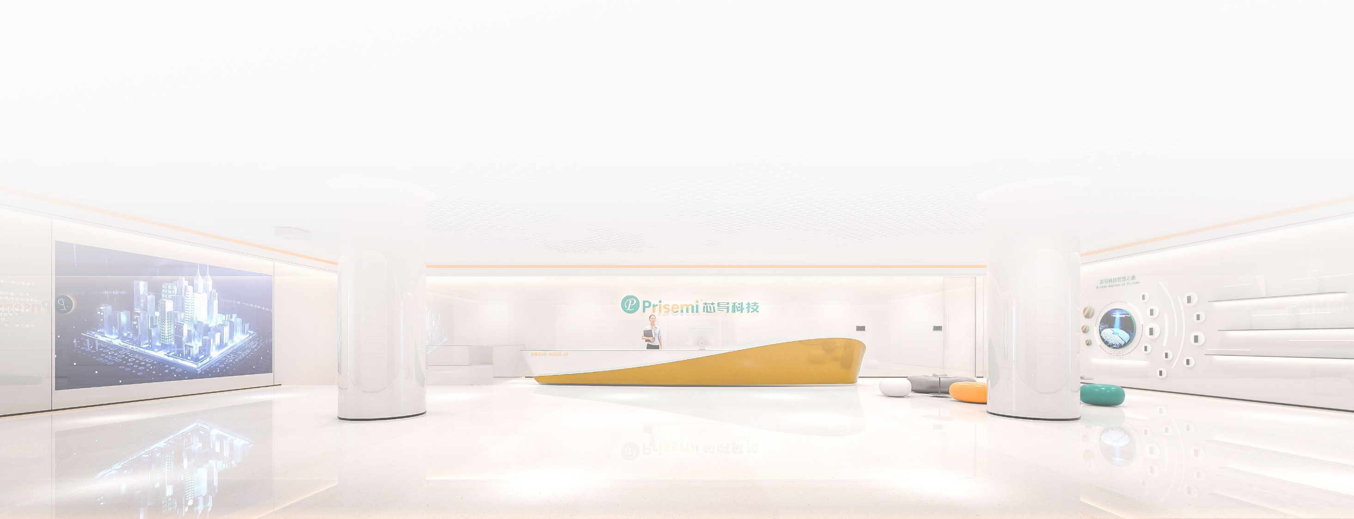
联系我们
Tel: +86-21-60870158
Fax: +86-21-60870156
Email: info@prisemi.com
Web: www.prisemi.com
总部地址：上海市张江集成电路设计产业园盛夏路565号D幢11层
深圳分公司： 深圳市南山区粤兴二道10号香港中文大学深圳研究院906-908室
无锡子公司：无锡市经济开发区太湖街道震泽路688号1号楼701-702室
Prisemi Confidential Document

